Slide 1
Starting to Write Code
A gentle introduction

Slide 2
You use software all the time
Computer programs
Web browsers (Chrome, Firefox, Safari, etc.)
Office tools (Word, Power Point, Excel, etc.)
Image editing tools (Photoshop, Lightroom, etc.)
Operating System, games
Phone Apps (Snapchat, Instagram, Camera, Phone)
Games that run on game consoles.
Embedded software on appliances you buy
Toasters, projectors, TVs
Cars, planes etc.

Slide 3
What is a program?
Also known as software
A set of instructions that are used to control a computer.
The instructions are written in a particular programming language
They are executed sequentially
Ultimately, they are converted from the programing language (designed to be readable by humans) to machine language (designed to run on a particular CPU).

Slide 4
Computer instructions
Each computer has a CPU (Central Processing Unit).
The CPU has many pins (about 1200). Each pin can be set to 0 (no voltage) or 1 (voltage) to send a signal to the CPU.
Putting a 1 on certain pins tells the CPU you want it to add 2 numbers. Putting it on other pins tells it you want to subtract 2 numbers.
There are only a couple thousand instructions you can send to the CPU. Everything more complicated has to be done in software.

Slide 5
Assembly Language
The lowest level language is called Assembly. Each family of processor (Intel, AMD, Arm) has their own Assembly language.
Today, very few people code directly in assembly as it’s extremely tedious.
It’s not something you’ll likely ever need to do.
This is because we use higher level languages which are easier for humans to read, and a special piece of software called a compiler which translates from the high level language to assembly

Slide 6
Higher level languages
Examples of higher level languages include:
C
C++
Java
C#
Python
PHP
Ruby
Golang
etc.

Slide 7
Language syntax
Each higher level language has its own syntax
Even though each is separate and distinctive, you’ll find that the syntax is similar across all the languages
Learning your first programing language will take a moment because it has to be so specific.
Learning your second and later languages will take a lot less time.
Most languages have formatting rules
Many require you to end each line with a ;
Most have a “skeleton” to get you started.

Slide 8
IDE
An IDE is an Integrated Development Environment
It’s where you’ll write your code
It’ll help you write you code (to some extent). It highlights syntax it recognizes which can help you see when you are making a mistake.
It allows you to save your files and keep them organized into projects
It also has a compiler built in, which compiles you code

Slide 9
What is Python
Python is a popular programming language. It was created by Guido van Rossum, and released in 1991.
It is used for:
web development (server-side),
software development,
mathematics,
system scripting.

Slide 10
What can Python do?
Python can be used on a server to create web applications.
Python can be used alongside software to create workflows.
Python can connect to database systems. It can also read and modify files.
Python can be used to handle big data and perform complex mathematics.
Python can be used for rapid prototyping, or for production-ready software development.

Slide 11
IDE for Python
There are many free cloud-based and local IDEs available to begin coding in Python.
Cloud-Based IDEs
CodeChef
GDB Online
Ideone
paiza.IO
Python Fiddle
PythonTutor
repl.it
TutorialsPoint
Local IDEs
IDLE
Thonny

Slide 12
Hello World
Example - Hello World
Input
# This program displays "Hello world!"
print("Hello world!")
Output:
Hello world!
Discussion
Each code element represents:
# begins a comment
print() calls the print function
"Hello world!" is the literal string to be displayed

Slide 13
Variables and Constants
One changes, The other doesn’t!

Slide 14
What is a variable?
Programming languages use variables to store information.
Think of them like buckets.
Each bucket has a name
Each bucket can hold one piece of information.
Likewise, a variable has:
A name
A value

Slide 15
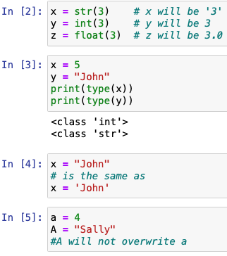
Types in variables
Variables do not need to be declared with any type,
and can even change the type after they have been set.
If you want to specify the data type of a variable, this
can be done with casting.
You can get the data type of a variable with the type()
function.
String variables can be declared either by using single
or double quotes:
Variable names are case-sensitive.

Slide 16
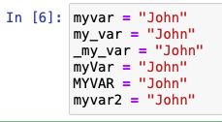
Creating Variables
A variable can have a short name (like x
and y) or a more descriptive name (age,
carname, total_volume). Rules for Python variables:
A variable name must start with a letter or the underscore character
A variable name cannot start with a number
A variable name can only contain alpha-numeric characters and underscores (A-z, 0-9, and _ )
Variable names are case-sensitive (age, Age and AGE are three different variables)

Slide 17
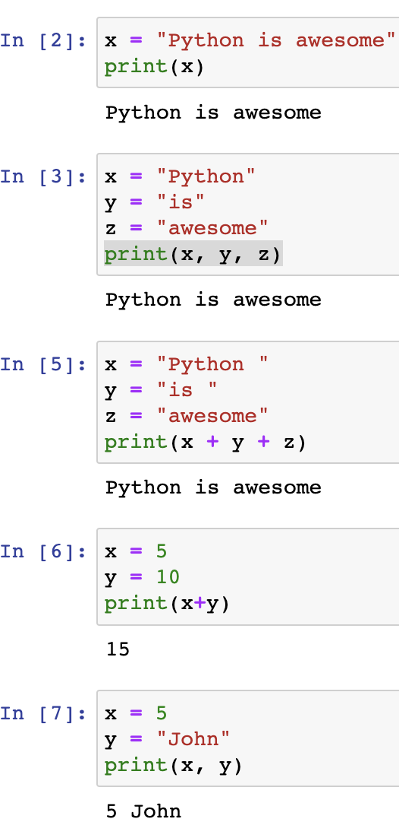
Printing Variables
In python, you can use the “print()” function to output variables:
Using a comma to output multiple variables :
Using the + operator to output multiple variables :
Using the + character works as a mathematical operator
to output multiple variables in the print() function is to separate
them with commas, which even support different data types:

Slide 18
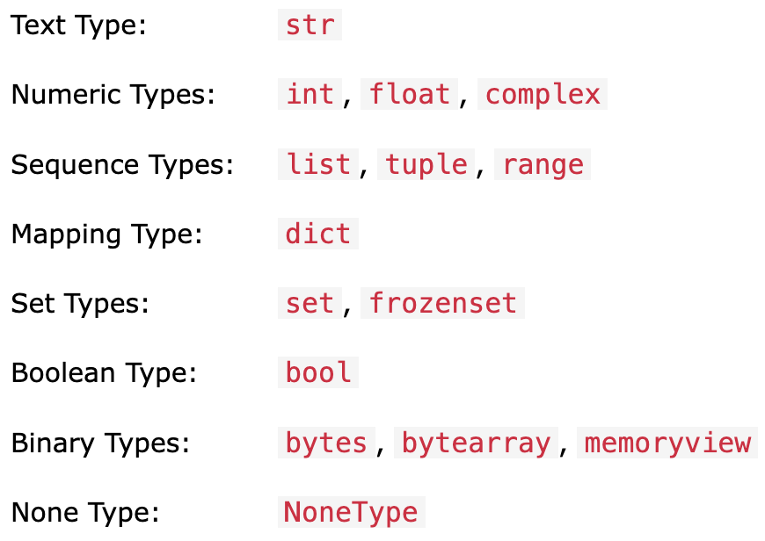
Data Types
A data type defines a set of values and the set of operations that can be applied to those values
Built-in Data Types: Python has the following data types built-in by default, in these categories -

Slide 19
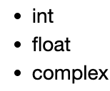
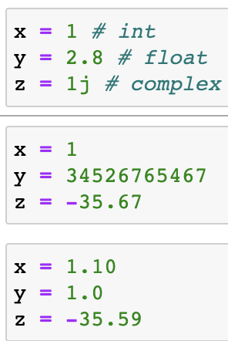
Python Numbers
There are three numeric types in Python:
Variables of numeric types are created when you
assign a value to them:
Int: Int, or integer, is a whole number, positive or negative,
without decimals, of unlimited length.
Float: "floating point number" is a number, positive or negative,
containing one or more decimals.

Slide 20
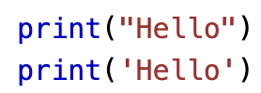
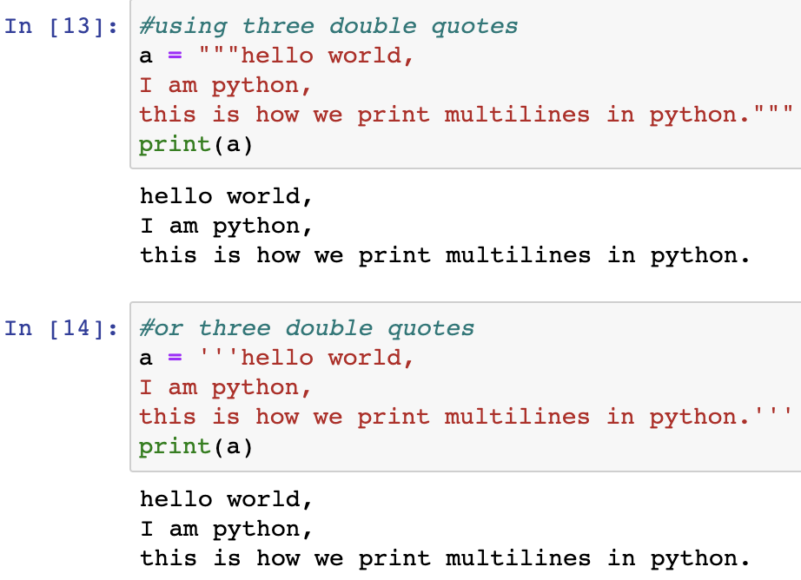
Strings Data Type
Strings in python are surrounded by either single quotation marks, or double quotation marks.
'hello' is the same as "hello".
You can display a string literal with the print() function:

Slide 21
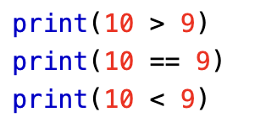
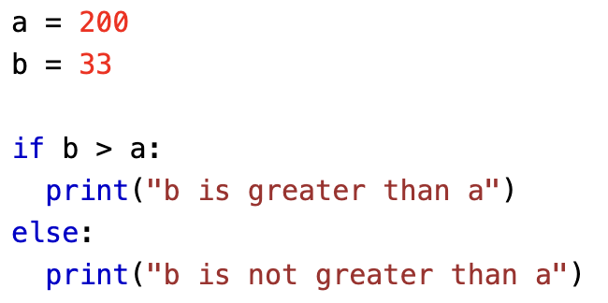
Boolean Data Type
A Boolean data type has one of two possible values (usually denoted true and false), intended to represent the two truth values of logic and Boolean algebra.
When you compare two values, the expression is evaluated, and Python returns the Boolean answer:
When you run a condition in an if statement, Python returns True or False:

Slide 22
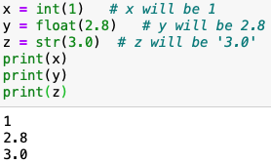
Python Casting
Casting python is therefore done using
constructor functions:
int() - constructs an integer number from an integer literal, a float literal
(by removing all decimals), or a string literal (providing the string represents a whole number)
float() - constructs a float number from an integer literal, a float literal or a string literal (providing the string represents a float or an integer)
str() - constructs a string from a wide variety of data types, including strings, integer literals and float literals

Slide 23
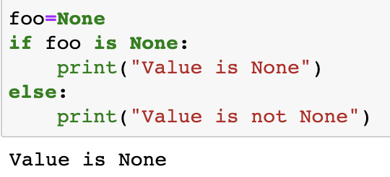
Nothing Data Type
A nothing data type is a feature of some programming languages which allows the setting of a special value to indicate a missing or uninitialized value rather than using the value 0 (zero).
None has a special status in Python. The None is used to define a null variable or an object, and it is a data type of the class NoneType.
Language | Reserved Word | Meaning
Python | None | no value

Slide 24
Reading &
Operators
Reading from the user,
Operators

Slide 25
Roles
We are often going to use names for different people who interact with software.
Programmer/Coder/Developer
This is you! The person who came up with the algorithm, converted it to source code, typed it into an IDE and compiled it.
User
This is the person who uses your software. It may not be you.
When you write code, you must keep the user in mind. What do you expect the user to see? What do you want the user to do when they use your software? What if the user does something wrong?

Slide 26
Reading info from the user
We have seen how print() can send information from the computer to the user.
What if you want the user to give some information back to the computer?
For example, the program you wrote prints: Hi, what is your name?
Now you want the computer to wait until the user answers the question.

Slide 27
In Python, we read from the user with input()
Python allows for user input.
All input is initially a str (string), you may need to convert to a different data type using casting before using the data.
Python 3.6 uses the input() method. The following example asks for the username, and when you entered the username, it gets printed on the screen:

Slide 28
Arithmetic Operators
Doing Math!

Slide 29
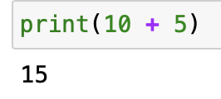
Python Operators
Operators are used to performing operations on variables and values.
In the example below, we use the + operator to add together two values:
Python divides the operators into the following groups:
Arithmetic operators
Assignment operators
Comparison operators
Logical operators
Identity operators*
Membership operators*
Bitwise operators*
* Outside of the scope of this course

Slide 30
Python Arithmetic Operators
Arithmetic operators are used with numeric values to perform common mathematical operations:
Operator | Name | Example
+ | Addition | x + y
- | Subtraction | x - y
* | Multiplication | x * y
/ | Division | x / y
% | Modulus | x % y

Slide 31
Python Assignment Operators
Assignment operators are used to assign values to variables:
age = 21
Assignment with an Expression:
total_cousins = 4 + 3 + 5 + 2
Assignment with Names in the Expression:
students_period_1 = 25
students_period_2 = 19
total_students = students_period_1 + students_period_2

Slide 32
Python Comparison Operators
Comparison operators are used to comparing two values:
Operator | Name | Example
== | Equal | x == y
!= | Not equal | x != y
> | Greater than | x > y
< | Less than | x < y
>= | Greater than or equal to | x >= y
<= | Less than or equal to | x <= y

Slide 33
Python Logical Operators
Logical operators are used to combining conditional statements:
Operator | Description | Example
and | Returns True if both statements are true | x < 5 and x < 10
or | Returns True if one of the statements is true | x < 5 or x < 4
not | Reverse the result, returns False if the result is true | not(x < 5 and x < 10)

Slide 34
Python Order of Precedence
Parentheses (start with inner most and work outwards)
Exponents
Multiplication, Division and Modulus
Addition and Subtraction
Comparison
Logical

Slide 35
Let’s practice some more
3 / 20 * 4 = ?
5 + 32 % 3 = ?
7 % 5 + 3 = ?
100 % 20 = ?
101 % 20 = ?

Slide 36
Python - Functions

Slide 37
Function
A block of organized, reusable code that is used to perform a single, related action.
Functions provide better modularity for your application and a high degree of code reusing.
As you already know, Python gives you many built-in functions like print(), etc. but you can also create your own functions. These functions are called user-defined functions.

Slide 38
Defining a function
Function blocks begin with the keyword def followed by the function name and parentheses ( ( ) ).
Any input parameters or arguments should be placed within these parentheses. You can also define parameters inside these parentheses.
The first statement of a function can be an optional statement - the documentation string of the function or docstring.
The code block within every function starts with a colon (:) and is indented.
The statement return [expression] exits a function, optionally passing back an expression to the caller. A return statement with no arguments is the same as return None.

Slide 39
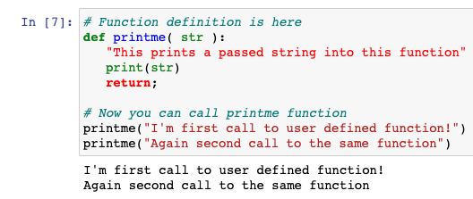
Calling a Function
Defining a function only gives it a name, specifies the parameters that are to be included in the function, and structures the blocks of code.
Once the basic structure of a function is finalized, you can execute it by calling it from another function or directly from the Python prompt. Following is the example to call printme() function −

Slide 40
Parameters and Arguments
A parameter is a special kind of variable used in a function to refer to one of the pieces of data provided as input to the function.
These pieces of data are the values of the arguments with which the function is going to be called/invoked.
An ordered list of parameters is usually included in the definition of a function, so that, each time the function is called, its arguments for that call are evaluated, and the resulting values can be assigned to the corresponding parameters.
Argument: A value provided as input to a function.
Parameter: A variable identifier provided as input to a function.

Slide 41
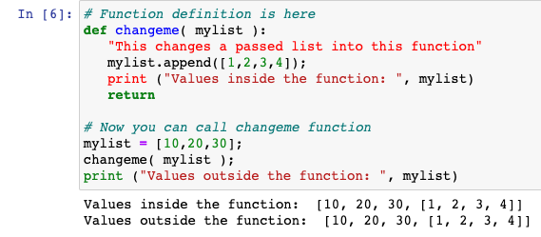
Pass by reference vs value
Python uses a mechanism, which is known as "Call-by-Object", sometimes also called "Call by Object Reference" or "Call by Sharing"
If you pass immutable arguments like integers, strings or tuples to a function, the passing acts like Call-by-value. It's different if we pass mutable arguments.
All parameters (arguments) in the Python language are passed by reference. It means if you change what a parameter refers to within a function, the change also reflects back in the calling function.

Slide 42
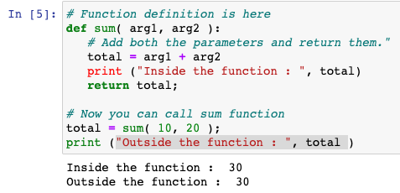
The return Statement
The statement return [expression] exits a function, optionally passing back an expression to the caller. A return statement with no arguments is the same as return None.
All the above examples are not returning any value. You can return a value from a function as follows −

Slide 43
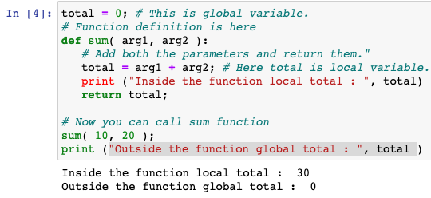
Scope of Variables
The scope of a variable determines the portion of the program where you can access a particular identifier.
The scope is of two types –
Global – variables defined outside a function body
Local – variables defined inside a function body

Slide 44
Challenge
Write a program that:
Reads in two numbers from the user
Multiplies the 2 numbers together
Prints out the result.

Slide 45
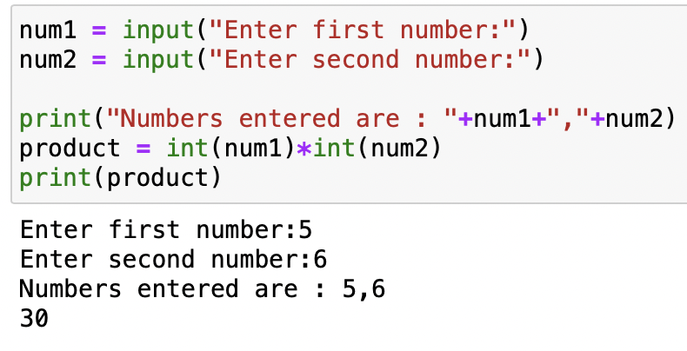
Answer

