Slide 1
Python If ... Else

Slide 2
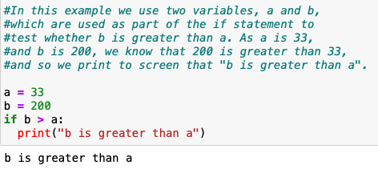
Python Conditions and If statements
Python supports the usual logical conditions from mathematics:
Equals: a == b
Not Equals: a != b
Less than: a < b
Less than or equal to: a <= b
Greater than: a > b
Greater than or equal to: a >= b
These conditions can be used in several ways, most commonly in "if statements" and loops.
An "if statement" is written by using the if keyword.

Slide 3
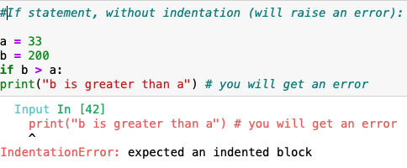
Indentation
Python relies on indentation (whitespace at the beginning of a line) to define scope in the code. Other programming languages often use curly-brackets for this purpose.

Slide 4
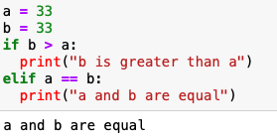
Elif
The elif keyword is pythons' way of saying "if the previous conditions were not true, then try this condition".
In this example a is equal to b, so the first condition is not true, but the elif condition is true, so we print to screen that "a and b are equal".

Slide 5
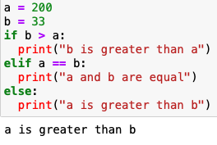
Else
The else keyword catches anything which isn't caught by the preceding conditions.

Slide 6
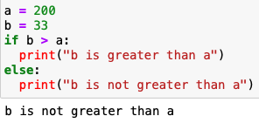
In this example a is greater than b, so the first condition is not true, also the elif condition is not true, so we go to the else condition and print to screen that "a is greater than b". You can also have an else without the elif:

Slide 7
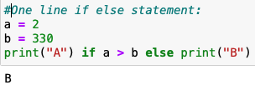
Shorthand If
If you have only one statement to execute, one for if, and one for else, you can put it all on the same line:
This technique is known as Ternary Operators or Conditional Expressions.

Slide 8
And
The and keyword is a logical operator, and is used to combine conditional statements:
Or
The or keyword is a logical operator, and is used to combine conditional statements:

Slide 9
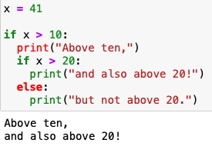
Nested If
You can have if statements inside if statements, this is called nested if statements.

Slide 10
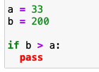
The pass Statement
if statements cannot be empty, but if you for some reason have an if statement with no content, put in the pass statement to avoid getting an error.

Slide 11
Exercise
Print "Hello World" if a is greater than b
a = 50
b = 10
__ a _ b_
print("Hello World")

Slide 12
Repetition
again, and again, and again…
(Sets and Loops)

Slide 13
Python Loops

Slide 14
Loops
In iteration control structures, a statement or block is executed until the program reaches a certain state, or operations have been applied to every element of a collection. This is usually expressed with keywords such as while, repeat, for, or do..until

Slide 15
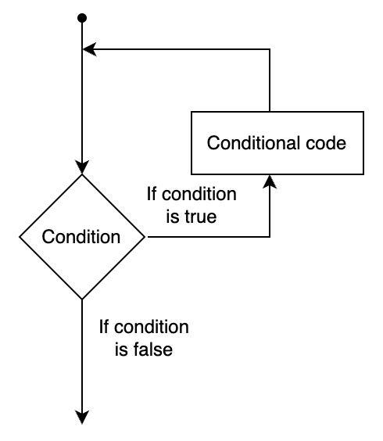
Computer algorithms need to be precise
A loop statement allows us to execute a statement or group of statements multiple times. Please see below flow chart:

Slide 16
Say Hello 3 times
print("Hello, World!")
print("Hello, World!")
print("Hello, World!")

Slide 17
Repetition
Wouldn’t it be great if you could just tell the computer to do something multiple times.
Ideally, you’d say something like:
do this 3 times:
print("Hello, World!")
You can do something like this, it’s called repetition, or a loop

Slide 18
Types of loop:-
While
For

Slide 19
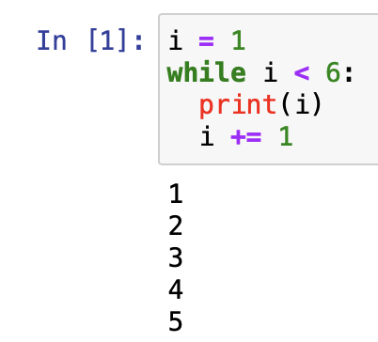
While loop
A while loop is a control flow statement that allows code to be executed repeatedly based on a given Boolean condition. The while loop can be thought of as a repeating if statement.
With the while loop, we can execute a set of statements as long as a condition is true.

Slide 20
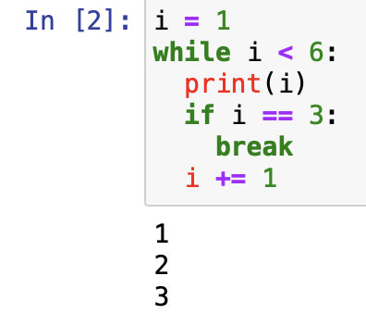
The while loop requires relevant variables to be ready, in this example, we need to define an indexing variable, i, which we set to 1.
The break Statement
With the break statement, we can stop the loop even if the while condition is true:
Exit the loop when i is 3:

Slide 21
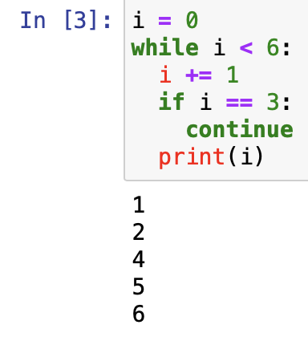
The continue Statement
With the continue statement, we can stop the current iteration, and continue with the next:
Continue to the next iteration if i is 3:

Slide 22
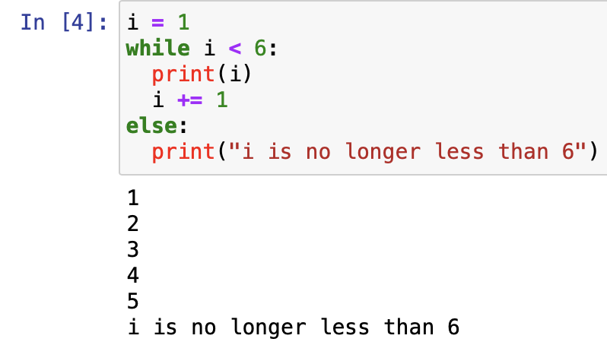
The else Statement
With the else statement, we can run a block of code once when the condition no longer is true:
Print a message once the condition is false:

Slide 23
For Loop
A for loop is used for iterating over a sequence (that is either a list, a tuple, a dictionary, a set, or a string).
This is less like the for keyword in other programming languages and works more like an iterator method as found in other object-orientated programming languages.
With the for loop, we can execute a set of statements, once for each item in a list, tuple, set etc.
Print each fruit in a fruit list:

Slide 24
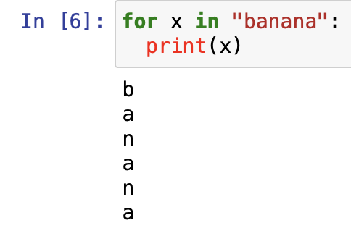
The for loop does not require an indexing variable to set beforehand.
Looping Through a String: Even strings are iterable objects, they contain a sequence of characters:
Loop through the letters in the word "banana":

Slide 25
The break Statement
With the break statement, we can stop the loop before it has looped through all the items:
Exit the loop when x is "banana":

Slide 26
Exit the loop when x is "banana", but this time the break comes before the print:

Slide 27
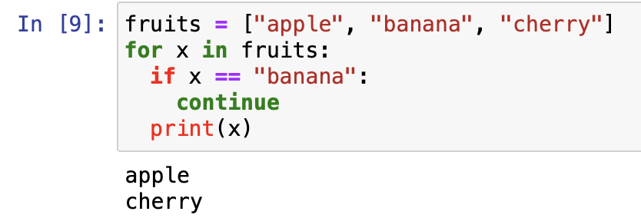
The continue Statement
With the continue statement we can stop the current iteration of the loop, and continue with the next
Do not print banana:

Slide 28
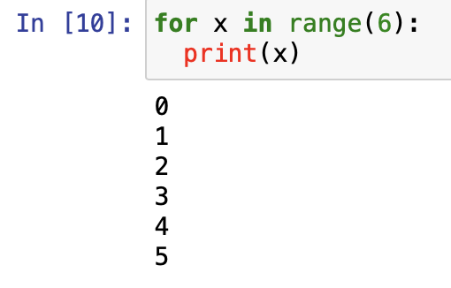
The range() Function
To loop through a set of code a specified number of times, we can use the range() function,
The range() function returns a sequence of numbers, starting from 0 by default, and increments by 1 (by default), and ends at a specified number.
Using the range() function:
Note that range(6) is not the values of 0 to 6, but the values 0 to 5.
The range() function defaults to 0 as a starting value, however it is possible to specify the starting value by adding a parameter: range(2, 6), which means values from 2 to 6 (but not including 6):

Slide 29
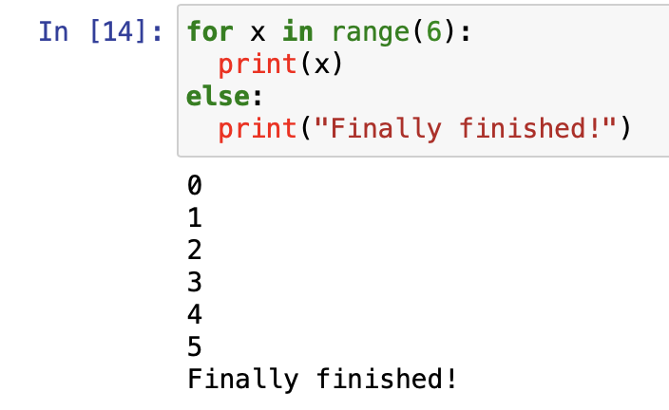
Else in For Loop
The else keyword in a for loop specifies a block of code to be executed when the loop is finished
Print all numbers from 0 to 5, and print a message when the loop has ended:

Slide 30
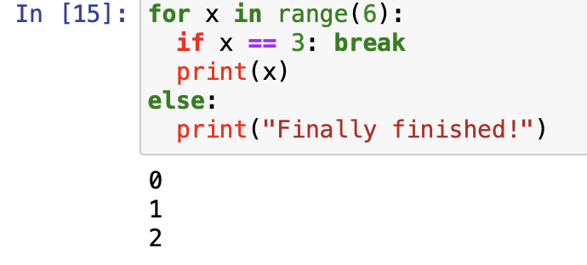
Example
Break the loop when x is 3, and see what happens with the else block:

Slide 31
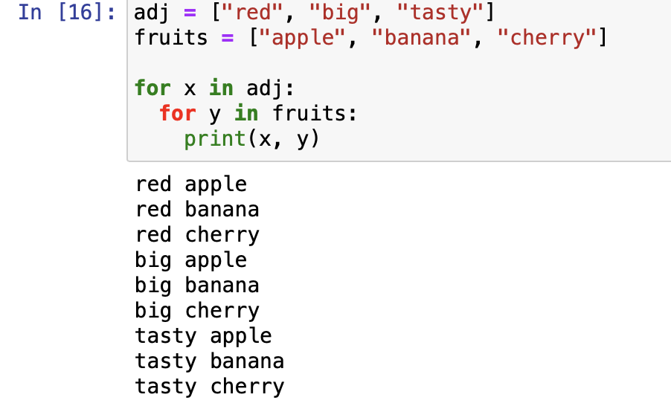
Nested Loops
A nested loop is a loop inside a loop.
The "inner loop" will be executed one time for each iteration of the "outer loop":
Print each adjective for every fruit:

Slide 32
The pass Statement
for loops cannot be empty, but if you for some reason have a for loop with no content, put in the pass statement to avoid getting an error.

Slide 33
Test Yourself With Exercises
Exercise: Loop through the items in the list of fruits.

