Slide 1
Steps to get started with Python Turtle
Once you have replit.com open in a browser, under “Create” you’ll see a button with a +, press it
In the template section you’ll choose Python (with Turtle)
In the title it’ll pick 3 random words, you can name it if you like.
Hit “Create Replit”

Slide 2
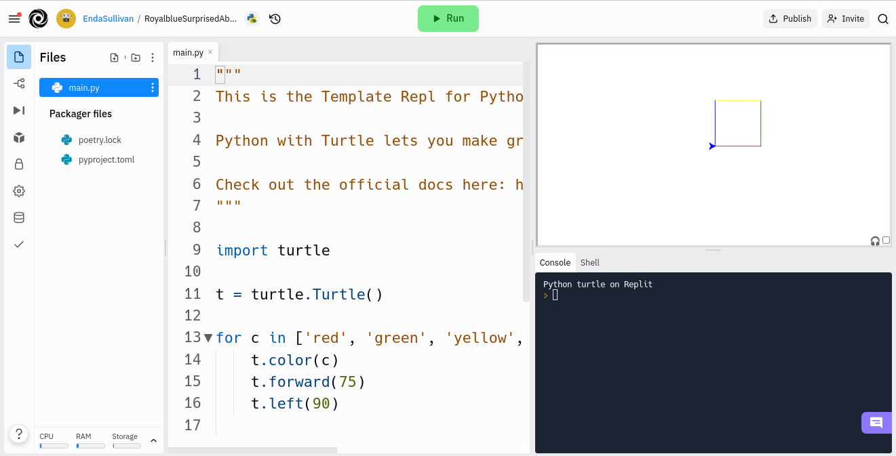
The main replit screen looks like this:
The center area is where you will write your instructions.
The right is where you will see the output

Slide 3
Let’s make our first line
Change the text in the center box to only include:
import turtle
t = turtle.Turtle()
t.forward(100)
Now hit the green Run button
Watch what happens

Slide 4
Congratulation!
You just programmed a turtle to draw a line.
This emulator uses a language called Python. Specifically, you are using the turtle library in Python.
The turtle library has a few commands we’ll use:
  t.forward(100)
  t.left(90)
  t.right(90)
  t.penup()
  t.pendown()
Notice the first 3 commands have a number in the ()’s. This is the parameter, you are specifying how far forward you want it to go, or how many degrees left or right you want it to turn.
penup and pendown don’t take any parameters, you just call the, and the “turtle” will either lift their pen or drop it (causing a line to be drawn).

Slide 5
What will this draw?
import turtle
t = turtle.Turtle()
t.forward(100)
t.left(90)
t.forward(100)
t.left(90)
t.forward(100)
t.left(90)
t.forward(100)

Slide 6
Answer
It draws a square. You should paste it into replit and see for yourself.
Why does it draw a square?
  We drew one line, then turned left 90 degrees
  We drew a second line (so far, an L), then turned left 90 degrees
  We drew another line (now a U) and another 90 degree turn left
  Finally, we drew the last line connecting the square
Figure out how to draw a pentagon
  Hint, it has 5 corners, and a full circle is 360 degrees, so each corner is 360/5.

Slide 7
Pentagon Solution
import turtle
t = turtle.Turtle()
t.forward(100)
t.left(72)
t.forward(100)
t.left(72)
t.forward(100)
t.left(72)
t.forward(100)
t.left(72)
t.forward(100)

Slide 8
Questions
Instead of left if you had gone right would it still have worked?
  Yes of course, it would just be drawn upside down from the previous drawing
What happens if we change all the forwards to 50 instead of 100?
  You get a smaller pentagon.
  Likewise, if you change it to 200 you’d get a bigger one.

Slide 9




Try to draw the following shapes:
A triangle pointing down
A triangle pointing up
An equals sign
A not equals sign

Slide 10
Don’t look ahead to the solution - TRY IT!!
A solution to each problem is on the next few slides, however you’ll learn nothing by looking at them, instead try these yourself.
Also note these are not the only solution, you may well come up with a different set of instructions which produce the same shape. Remember there is often more than one solution to a problem.

Slide 11
Downward Triangle
import turtle
t = turtle.Turtle()
t.forward(50)
t.right(120)
t.forward(50)
t.right(120)
t.forward(50)

Slide 12
Upward Triangle
import turtle
t = turtle.Turtle()
t.forward(50)
t.left(120)
t.forward(50)
t.left(120)
t.forward(50)

Slide 13
Equals Sign
t = turtle.Turtle()
t.forward(50)
t.right(90)
t.penup()
t.forward(25)
t.right(90)
t.pendown()
t.forward(50)

Slide 14
Not equals sign
import turtle
t = turtle.Turtle()
t.forward(50)
t.right(90)
t.penup()
t.forward(25)
t.right(90)
t.pendown()
t.forward(50)
t.penup()
t.left(90)
t.forward(10)
t.left(135)
t.pendown()
t.forward(70)

Slide 15
Lines…circles?
How do we draw a circle?
Effectively you draw a dot, move left or right 1 degree, draw another dot, and do that again and again until you’ve reached 360 degrees.
That will be a lot of lines:
  t.forward(1)
  t.right(1)
  t.forward(1)
  t.right(1)
Surely there is a better way?

Slide 16
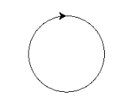
A Circle
import turtle
t = turtle.Turtle()
i=1
while i<360:
t.forward(1)
t.right(1)
i=i+1

Slide 17

Your turn
Draw a semi circle
Note this is a bit tricky…the turtle points to the right when you start, but you probably want him to point down to start with, otherwise you’ll get a sideways semicircle.

