Slide 1
CSE 1321
Module 3 – Part 1
Selection Statements

Slide 2
Topics
Flow of Control
if statements
elif statements
else statements
match statements

Slide 3
Motivation
In the programs we have written thus far, statements are executed one after the other, in the order in which they appear.
However, programs often need more than one path of execution. Many algorithms require a program to execute some statements only under certain circumstances. This can be accomplished with decision structures.

Slide 4
Flow of Control
The order of statement execution is called the flow of control
By default, execution is linear: one statement after another
However, we can:
  decide whether or not to execute a particular statement
  execute a statement over and over, repetitively
These selection (decision) statements are based on boolean expressions (or conditions) that evaluate to True or False

Slide 5
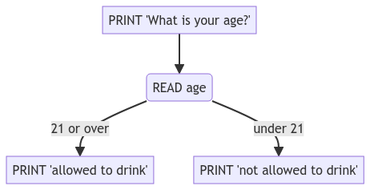
A Flow Diagram

Slide 6
The Boolean
A Boolean resolves to either True or False
You can get Boolean values several different ways
  Simple
  Complex
These Booleans are used to make decisions
The following are always False:
  None and False
  Zero of any Numeric types (0, 0.0, 0j, etc.)
  Empty sequences
Everything else is (usually) True

Slide 7
Selection Statements
A Selection (conditional) statement allows us to choose which statements will be executed next:
  if – block of code executes if a Boolean expression is true. If the Boolean expression is False, the block of code is skipped.
  elif – must come under an if or an elif. Will execute its block of code if the Boolean expression is True and if the if/elif it is attached to evaluates to False.
  else – must come under an if or elif., and only one else can be present per if block. Will execute if the if and all preceding elif (if present) evaluate to False.
  switch – lets the value of a variable determine where the program will branch to.

Slide 8
Relational Operators (reminder)
Create a True or False using a relational operator:
> greater than
< less than
== equals
.equals( ) method for strings
!= not equal
>= greater than or equal
<= less than or equal
Note the difference between the equality operator (==) and the assignment operator (=)

Slide 9
Relational Operators Example
Literal Example:
5 > 3 // true
6 != 6 // false
True == (4 <=2) // false
‘c’ != ‘b’ // true
Variable Example:
Num1 = 5
Num2 = 7
Result = Num2 > Num1 // Result is true

Slide 10
Logical Operators (reminder)
Boolean expressions can also use the following logical operators:
  Logical NOT
  Logical AND
  Logical OR
They all take Boolean operands and produce Boolean results
Logical NOT is a unary operator (it operates one operand)
Logical AND and OR are binary operators (it operates on two operands)

Slide 11
Logical Operators (NOT)
The logical NOT operation is also called logical negation or logical complement
If some Boolean condition a is True, then NOT a is False; if a is False, then NOT a is True
Logical expressions can be shown using a truth table

Slide 12
Logical Operators (AND and OR)
The logical AND expression
a AND b
is True if both a and b are True, and False otherwise
The logical OR expression
a OR b
is True if either a or b is True, or both are True, and False otherwise

Slide 13
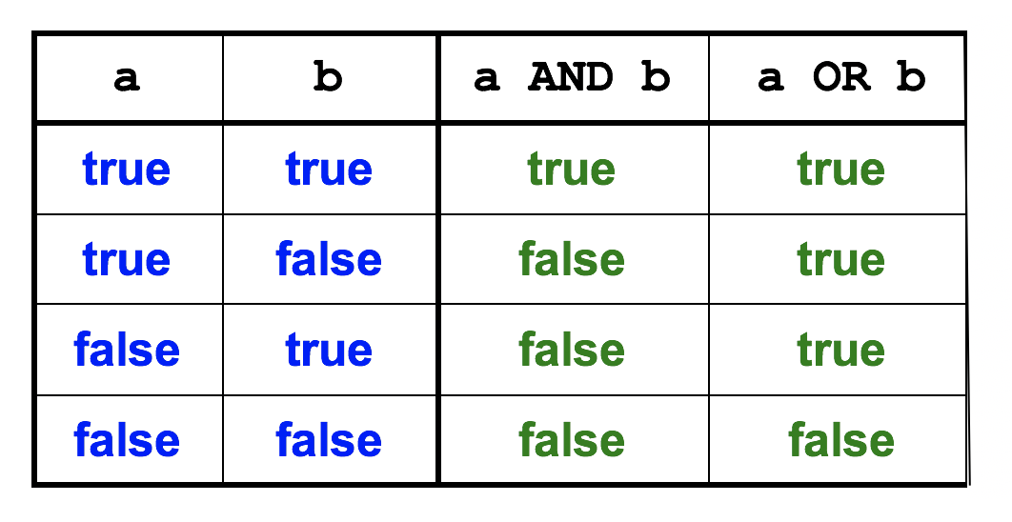
Logical Operators

Slide 14
Logical Operators in Boolean Expressions
Expressions can form complex conditions
if ((total < (MAX + 5)) and (not found)):
print("Processing…")
Mathematical operators have higher precedence than the Relational and Logical operators
Relational operators have higher precedence than Logical operators

Slide 15
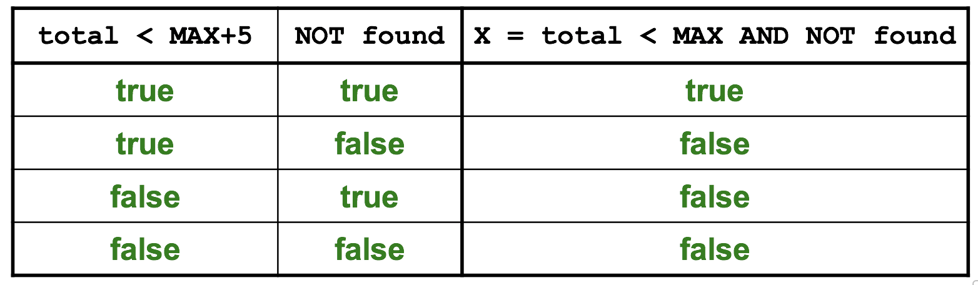
Boolean Expressions
Specific expressions can be evaluated using truth tables
Given X = ((total < (MAX + 5)) and (not found))
What is the values of X ?

Slide 16
Notes on Indentation
In Python:
Necessary
A code is considered to be “inside” the body of an if only if it is indented relative to that if
E.g.:
if True:
print(“I will always execute”)
In other programing languages
Might make no difference, but crucial for readability and debugging.
Code inside the IF statement is indented and should also be enclosed in curly braces { }.

Slide 17
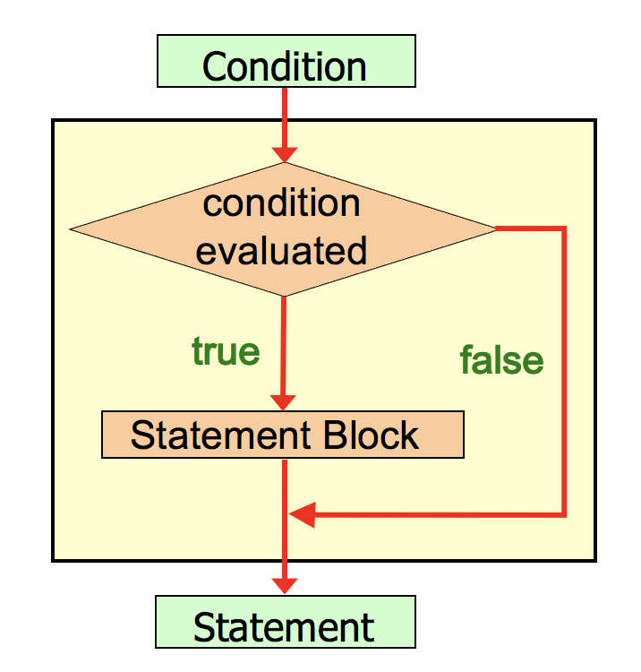
Logic of an IF Statement

Slide 18
Now Let’s Do Something!
Using the IF statement, we can decide whether or not to execute some code
Has format:
if (condition):
// all the code that’s here will only execute
// IF and only IF the condition above is true

Slide 19
Problem Statement
Write a program to convert user input of Celsius temperature to Fahrenheit. Display the converted temperature to the user. Issue a heat warning IF temperature is at least 90 degrees Fahrenheit.
Fahrenheit = 9.0 / 5.0 * Celsius + 32

Slide 20

Python - IF Statement
if __name__ == “__main__”:
celsius = float(input(“Enter Celsius temperature: ”))
fahrenheit = 9.0 / 5.0 * celsius + 32
print(Fahrenheit)
if (fahrenheit >= 90):
print(“heat warning”)

Slide 21
Python – Logical Operators - OR
if __name__ == “__main__”:
celsius = float(input(“Enter Celsius temperature: ”))
fahrenheit = 9.0 / 5.0 * celsius + 32
print(fahrenheit)
if 20 <= fahrenheit or fahrenheit >= 90:
print(“Extreme weather warning!”)

Slide 22
Structure of an IF-ELSE Statement
IF has a counterpart – the ELSE statement
Has format:
if (condition):
statementBlock that executes if condition is true
else:
statementBlock that executes if condition is false
IF the condition is true, statementBlock1 is executed; IF the condition is false, statementBlock2 is executed
Notice there is no (condition) after the ELSE statement.
One or the other will be executed, but not both

Slide 23
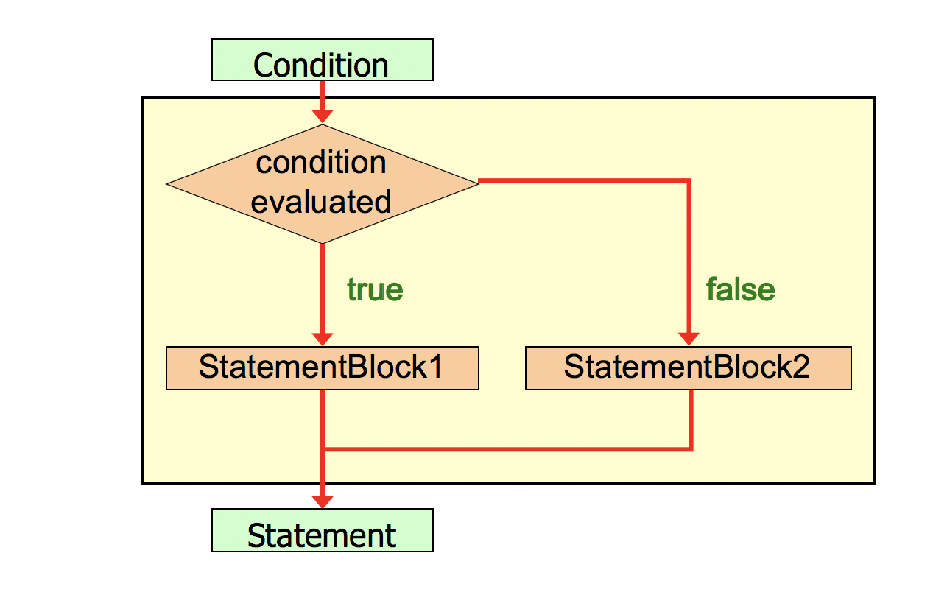
Logic of an IF-ELSE statement

Slide 24
Problem Redefined
Original Problem Statement: Write a program to convert user input of Celsius temperature to Fahrenheit. Display the converted temperature to the user. Issue a heat warning IF temperature is at least 90 degrees Fahrenheit.
Add: IF the temperature is not that high, output a message to the user.

Slide 25
Python – IF-ELSE Statement
if __name__ == “__main__”:
celsius = float(input(“Enter Celsius temperature: ”))
fahrenheit = 9.0 / 5.0 * celsius + 32
print(fahrenheit)
if fahrenheit >= 90:
print(“heat warning!”)
else:
print(”there is no extreme heat”)

Slide 26
Python – Logical Operators - AND
if __name__ == “__main__”:
celsius = float(input(“Enter Celsius temperature: ”))
fahrenheit = 9.0 / 5.0 * celsius + 32
print(fahrenheit)
if fahrenheit >= 50 and Fahrenheit <= 80:
print(“It’s a pretty good day!”)
else:
print(”It may be better to stay inside.”)

Slide 27
Structure of an IF-ELSE-IF
Selecting one from many
As soon as one is true, the rest are not considered
Has format:
if (condition):
//statementBlock that executes if the above boolean is true
elif (condition):
//statementBlock that executes if the above boolean is true
elif (condition):
//statementBlock that executes if the above boolean is true
else
//statementBlock that executes if the nothing matched above
Note: only one set of statements will ever
execute. Trailing else is optional

Slide 28
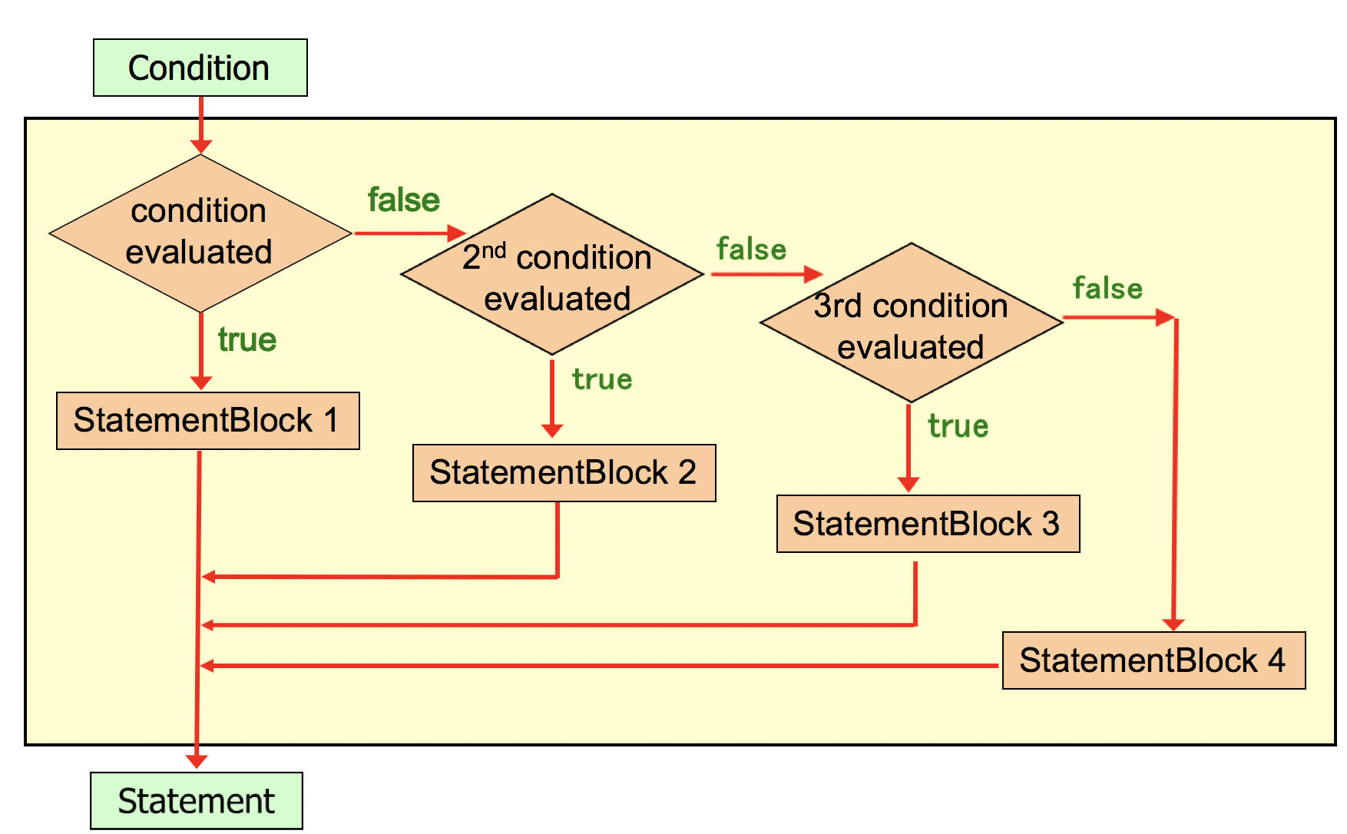
8. Logic of an IF-ELSE-IF

Slide 29
Problem Redefined
Original Problem Statement: Write a program to convert user input of Celsius temperature to Fahrenheit. Display the converted temperature to the user. Issue a heat warning if temperature is at least 90 degrees Fahrenheit.
Add: two additional messages to recommend an action based on temperature (in the 70’s or in the 80’s), and a trailing else.

Slide 30
Python – IF-ELIF-ELSE
if __name__ == “__main__”:
celsius = float(input(“Enter Celsius temperature: ”))
fahrenheit = 9.0 / 5.0 * celsius + 32
print(fahrenheit)
if fahrenheit >= 90:
print(“heat warning”)
elif fahrenheit >= 80:
print(“it is warm, but there is no extreme heat”)
elif fahrenheit >= 70:
print(“the temperature is pleasant and suggest a picnic”)
else:
print(”a suggestion to take a jacket”)

Slide 31
Python – IF-ELIF-ELSE – BAD VERSION
if __name__ == “__main__”:
celsius = float(input(“Enter Celsius temperature: ”))
fahrenheit = 9.0 / 5.0 * celsius + 32
print(fahrenheit)
if fahrenheit >= 70:
print(“the temperature is pleasant and suggest a picnic”)
elif fahrenheit >= 80:
print(“it is warm, but there is no extreme heat”)
elif fahrenheit >= 90:
print(“heat warning”)
else:
print(”a suggestion to take a jacket”)

Slide 32
Nested IF statements
An if statement can be put inside of another if statement
This is called a “nested if statement”
The second if will be evaluated only if the first if evaluates to true
if __name__ == “__main__”:
age = 0,
country = input(“Enter your country of residence: ”)
if (country == “US”):
age = int(input(“How old are you? ”)
if (age >= 21):
print(“You are allowed to drink”) #This IF is nested inside the IF above
else :
print(“You are not allowed to drink”) #part of the nested IF
else:
print(“Drinking laws unknown”) #part of the IF evaluating the user’s country

Slide 33
The match Statement (Python 3.11+)
The match statement provides another way to decide which statement to execute next
The match statement uses a variable and attempts to match the value to one of several possible cases (cases)
Each case contains a value and a list of statements
The flow of control transfers to statement associated with the first case value that matches
Allow for relational checks (not all languages allow for this)

Slide 34
Structure of a match
The general syntax of a match statement is:
match (variable):
case 1:
statementBlock
case 2:
statementBlock
case 3:
statementBlock
case ...
...
case _:
statementBlock

Slide 35
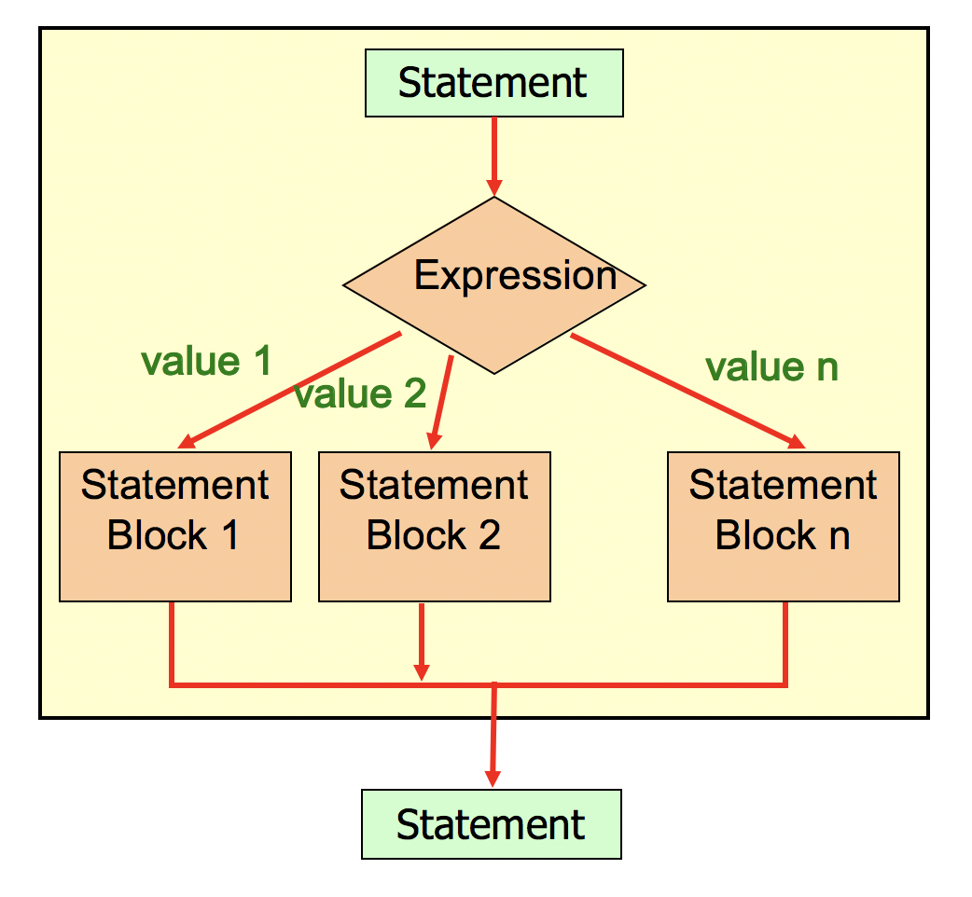
Logic of match statement

Slide 36
Default Case
A match statement can have an optional default case
The default case uses an underscore (_)
If the default case is present, control will transfer to the default case if no other case value matches
If there is no default case, and no other value matches, control falls through to the statement after the switch statement

Slide 37
Problem Redefined
Original Problem Statement: Write a program to convert user input of Celsius temperature to Fahrenheit. Display the converted temperature to the user.
Add: Using the Fahrenheit temperature and division, determine the conditions outside (i.e., in the 100’s, 90’s, etc.). Use a switch statement to recommend user action based on the result. If it is in the 60’s or below, suggest the user take a jacket.

Slide 38
Python – match Statement
# Read user input like before
conditions = int(fahrenheit / 10)
print("It is in the " + str(conditions) + "0's.")
match conditions:
case 10:
print(“stay inside” )
case 9:
print(“be careful due to heat” )
case 8:
print(“it is hot, but not extreme” )
case 7:
print(“pack a picnic” )
case _:
print(“take a jacket” )

Slide 39
Python – match with relational check
# Read user input like before
match fahrenheit:
case fahrenheit if fahrenheit >= 100:
print(”stay inside”)
case fahrenheit if fahrenheit >= 90:
print(”be careful due to heat”)
case fahrenheit if fahrenheit >= 80:
print(”it is hot, but not extreme”)
case fahrenheit if fahrenheit >= 70:
print(”pack a picnic”)
case _:
print("take a jacket")

Slide 40
Summary
Boolean values can be generated several ways
Use the if statement to decide which path to take
Use the else to take the alternate path
The if-else-if statements allow for selecting one from many
Use the match statement to allow a variable to determine program path

