Slide 1
Module 4 – Part 3
Rects and Movement

Slide 2
Topics
Rects
  What is a Rect
  Creating Rects
  Associating Rects and Surfaces
  Moving Rects

Slide 3
Rects – Creating a Rect
Rects are objects used to store spatial information
Specifically, a Rect is a rectangular area
It has x and y coordinates, as well as a width and height
To create a Rect, use the following constructor:
  rect = pygame.Rect(x, y, width, height)
Remember: In computer graphics, the origin of anything is at the top left!

Slide 4
Rects – Using Rects and Surfaces
Given that a Rect is a set of coordinates, plus an area, we can use the Rect when building our Surfaces.
  rect = pygame.Rect(x, y, width, height)
  surf = pygame.Surface((rect.w, rect.h))
The Surface above now has the width and the height of our Rect.
  Notice we still have to enclose the width and the height in a tuple.

Slide 5
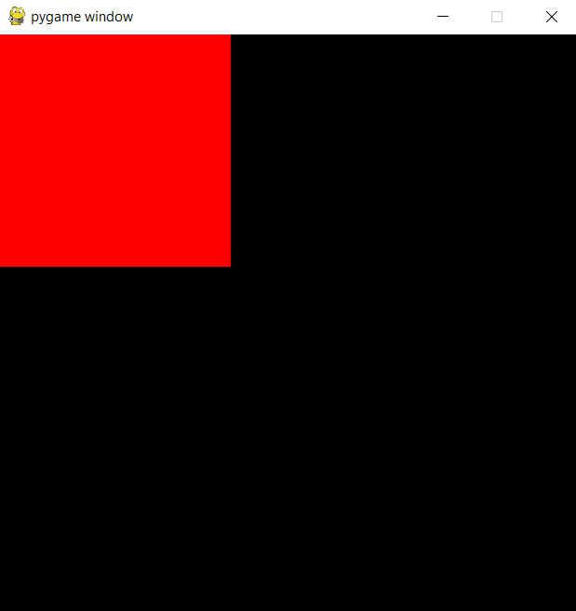
Rects – Using Rects and Surfaces
import pygame
pygame.init()
screen = pygame.display.set_mode((500,500))
rect1 = pygame.Rect(0, 0, 200, 200)
surf = pygame.Surface((rect1.w, rect1.h))
surf.fill((255,0,0))
screen.blit(surf, (rect1.x, rect1.y))
pygame.display.flip()
running = True
while running:
for event in pygame.event.get():
if event.type == pygame.QUIT:
running = False

Slide 6
Rects – Why use Rects?
Why go through the extra work of creating a Surface based on a Rect?
Rects have lots of helpful fields:
Helpful Fields:
x,y
top, left, bottom, right
topleft, bottomleft, topright, bottomright
midtop, midleft, midbottom, midright
center, centerx, centery
size, width, height
w,h
Instead of having to calculate the coordinates of the bottom right corner of a Rect:
coordinates = (rect.x + rect.width , rect.y + rect.height)
We can simply access the appropriate field:
coordinates = rect.bottomright
Any updates top one of the fields will update the other fields as appropriate

Slide 7
Rects – Moving Rects
Perhaps the most useful method of a Rect is move()
It takes in two integers, and uses them to increment the Rect’s x and y coordinates
The move() method returns a Rect, so make sure to store it!
rect = pygame.Rect(0, 0, 50, 50)
rect = rect.move(5,5)
The Rect above was created at coordinates (0,0).
The new Rect was moved to (5,5)
Calling move(5,5) again creates a new Rect with coordinates (10,10)

Slide 8
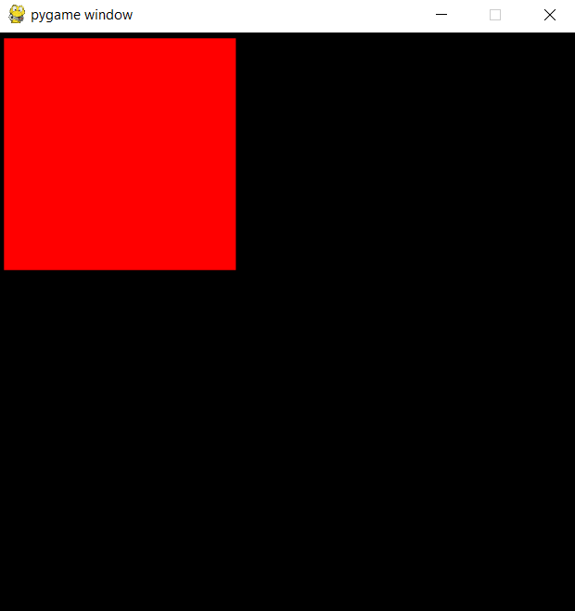
Rects – Moving Rects
import pygame
pygame.init()
screen = pygame.display.set_mode((500,500))
rect1 = pygame.Rect(0, 0, 200, 200)
surf = pygame.Surface((rect1.w, rect1.h))
surf.fill((255,0,0))
rect1 = rect1.move(5,5)
screen.blit(surf, (rect1.x,rect1.y))
pygame.display.flip()
running = True
while running:
for event in pygame.event.get():
if event.type == pygame.QUIT:
running = False

Slide 9
Rects – Moving Rects
Our Rect has moved 5 pixels to the right and 5 pixels down.
However, we want it to keep moving instead of just move it once.
As such, we need call move() inside the main loop.
We also need to call the Display’s blit() and flip() inside the loop
  If we don’t, the Rect will move, but the screen will not draw the Rect’s new position

Slide 10
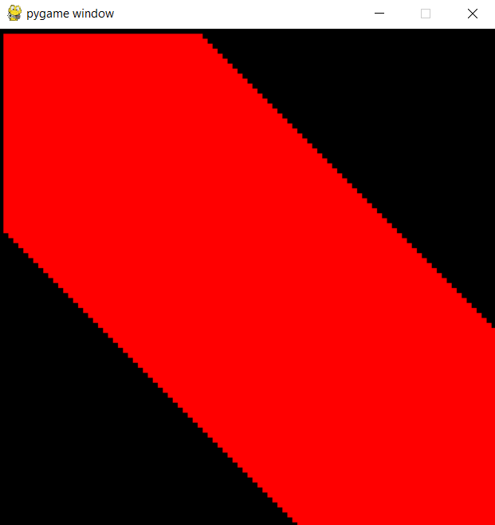
Rects – Moving Rects
import pygame
pygame.init()
screen = pygame.display.set_mode((500,500))
rect1 = pygame.Rect(0, 0, 200, 200)
surf = pygame.Surface((rect1.w, rect1.h))
surf.fill((255,0,0))
running = True
while running:
for event in pygame.event.get():
if event.type == pygame.QUIT:
running = False
rect1 = rect1.move(5,5)
screen.blit(surf, (rect1.x,rect1.y))
pygame.display.flip()

Slide 11
Rects – Moving Rects
The result is unexpected:
  Was expecting a red square to move across the screen
  Got a streak of red instead
We got what we got for 2 reasons:
  We are updating our Display too often
  We are not erasing where the Rect was previously
  We can fix the Display updating too often by using pygame.Clock
    We’ll cover what it does later on

Slide 12
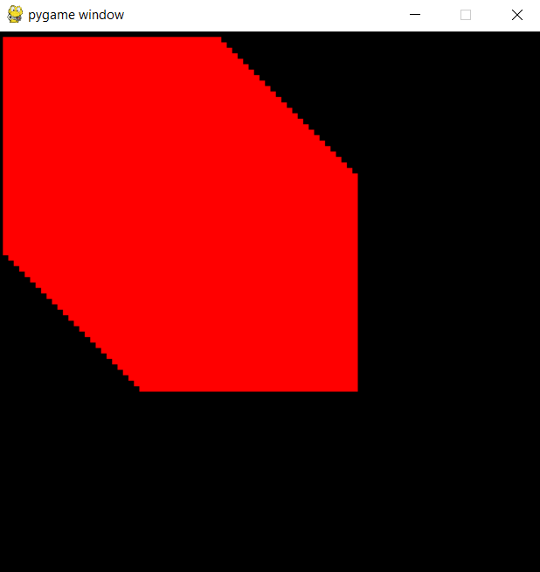
Rects – Moving Rects
import pygame
pygame.init()
clock = pygame.time.Clock()
screen = pygame.display.set_mode((500,500))
rect1 = pygame.Rect(0, 0, 200, 200)
surf = pygame.Surface((rect1.w, rect1.h))
surf.fill((255,0,0))
running = True
while running:
for event in pygame.event.get():
if event.type == pygame.QUIT:
running = False
rect1 = rect1.move(5,5)
screen.blit(surf, (rect1.x,rect1.y))
pygame.display.flip()
clock.tick(60)

Slide 13
Rects – Moving Rects
The square is now moving across the screen
  It was already moving before, but it was moving so fast that we could not perceive it
However, it’s still leaving a streak behind
That is because the Display’s blit() is only updating the coordinates we are giving it
We are drawing a new square at the new position, but we aren’t erasing the old square!

Slide 14
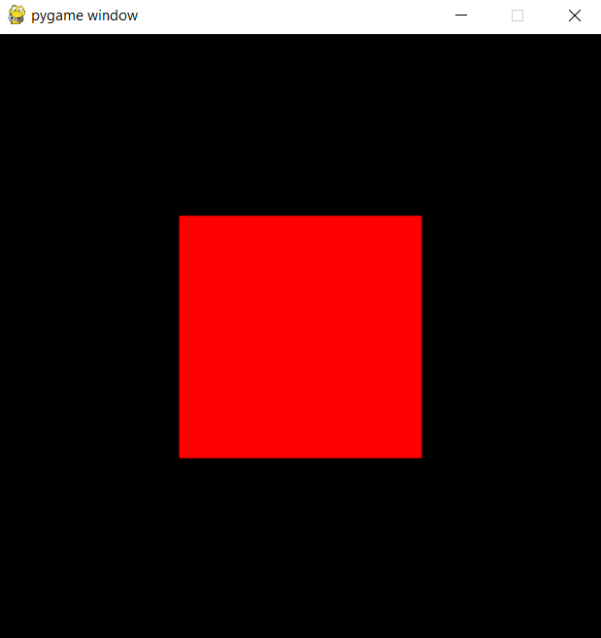
Rects – Moving Rects
import pygame
pygame.init()
clock = pygame.time.Clock()
screen = pygame.display.set_mode((500,500))
rect1 = pygame.Rect(0, 0, 200, 200)
surf = pygame.Surface((rect1.w, rect1.h))
surf.fill((255,0,0))
running = True
while running:
for event in pygame.event.get():
if event.type == pygame.QUIT:
running = False
rect1 = rect1.move(5,5)
screen.fill(color=(0,0,0))
screen.blit(surf, (rect.x,rect.y))
pygame.display.flip()
clock.tick(60)

Slide 15
Rects – Moving Rects
To reiterate what happened in the last slide, inside the main loop, right after the for loop:
We updated the Rect’s coordinates down by 5 and right by 5
We filled the Display with the color black
  If we drew the Display at this point, there would be no red square
We blitted the red square Surface onto the Display using the Rect’s coordinates
We updated the Display with flip()
These are the basics of movement!

Slide 16
Rects – Staying in-bounds
You may have noticed that our red square disappeared at the bottom right of the screen
Its position is still being updated, but it’s being drawn outside of the Display’s Surface
Sometimes, you may want to move things outside of a Surface
But not always: How do we keep our square in the screen?
We check if the square’s new position would make it go off-screen!

Slide 17
Rects – Staying in-bounds
import pygame
pygame.init()
clock = pygame.time.Clock()
screen = pygame.display.set_mode((500,500))
rect1 = pygame.Rect(0, 0, 200, 200)
rect1_speed = [5,5]
surf = pygame.Surface((rect1.w, rect1.h))
surf.fill((255,0,0))
running = True
while running:
for event in pygame.event.get():
if event.type == pygame.QUIT:
running = False
if (rect1.x < 0 or rect1.x > 300) and (rect1.y < 0 or rect1.y > 300):
rect1_speed[0] = -rect1_speed[0]
rect1_speed[1] = -rect1_speed[1]
rect1 = rect1.move(rect1_speed)
screen.fill(color=(0,0,0))
screen.blit(surf, (rect1.x,rect1.y))
pygame.display.flip()
clock.tick(60)

Slide 18
Rects – Staying in-bounds
We’ve added a variable to keep track of the Rect’s speed (i.e.: how many pixels it moves every time the main loop runs)
We’ve also added an IF statement to check if the Rect is outside the bounds of the screen
If it is, we invert its speed
If our screen were larger (e.g.: 600x600), our IF statement would have to check against 400, instead of 300.

Slide 19
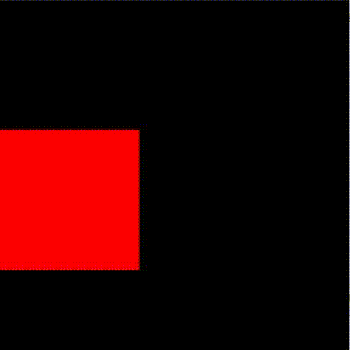
See if you can get the square to do this
(go in circles around the screen)

Slide 20
if rect1.x == 0:
if rect1.y == 0:
rect1_speed = [0, 5]
elif rect1.y == 300:
rect1_speed = [5, 0]
elif rect1.x == 300:
if rect1.y == 0:
rect1_speed = [-5, 0]
elif rect1.y == 300:
rect1_speed = [0, -5]

Slide 21
Summary
Rects are objects which store area and coordinate information
Use it in conjunction with Surfaces to keep track of where a Surface should be drawn on another Surface
Rects are more convenient to use as they have fields which help determine some of their useful points
Use move() to update a Rect’s position
The Rect’s new position must be blitted onto the screen
Pygame’s Clock should be used to slow down the game

