Slide 1
Module 4 – Part 7
File IO

Slide 2
Overview
Loading files to and from disk isn’t something specifically related to Pygame
The game you are designing might require reading from text files or writing to text files
We’ll go over the basics of File I/O (File Input/Output) here
More will be covered in 1322

Slide 3
Reading from files
General syntax for reading from a text file
with open(“filename”, mode=“r”, encoding="utf-8") as f:
pass
As long as you are inside the scope of the with statement, you can read from the file
This is done by calling special functions from the f object that the open() method creates

Slide 4
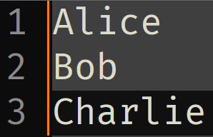
Reading from files – Reading all as a string
read() reads all lines inside the file and stores them as a string
lines = “”
with open("text.txt", mode="r", encoding="utf-8") as f:
lines = f.read()
text.txt
f.read()
lines = “Alice\nBob\nCharlie”

Slide 5
Reading from files – Reading all as a list
readlines() reads all lines inside the file and stores them as a list of strings
lines = “”
with open("text.txt", mode="r", encoding="utf-8") as f:
lines = f.readlines()
text.txt
f.readlines()
lines = [‘Alice\n’,
‘Bob\n’,
‘Charlie’]

Slide 6
Writing to files
General syntax for writing from a text file
with open(“filename”, mode=“w”, encoding="utf-8") as f:
pass
As long as you are inside the scope of the with statement, you can write to the file
This is done by calling special functions from the f object that the open() method creates
Notice that the mode has changed to “w”

Slide 7
Writing to files – String as an input
write() takes in a string and writes it to the file
Input must be a string
lines = “Alice\nBob\nCharlie”
with open("text.txt", mode=“w", encoding="utf-8") as f:
f.write(lines)
text.txt
f.write()
lines = ‘Alice\nBob\nCharlie’

Slide 8
Writing to files – List as an input
writelines() takes in a list of strings and writes it to the file
Input must be a list of strings
lines = [‘Alice\n’, ‘Bob\n’, ‘Charlie’]
with open("text.txt", mode=“w", encoding="utf-8") as f:
f.writelines(lines)
text.txt
f.writelines()
lines = [‘Alice\n’,
‘Bob\n’,
‘Charlie’]

Slide 9
Writing to files – Writing vs appending
There are two write modes available: writing and appending
Writing: If the file already exists, erases its contents and writes to the file
Appending: If the file already exists, writes at the end of the file
  Appending mode is mode=“a”
In both cases, if the file does not exist, it will be created

Slide 10
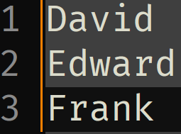
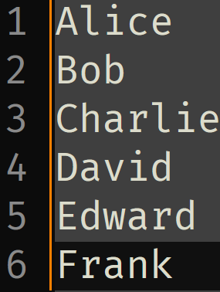
Writing to files – Writing vs appending
lines = “David\nEdward\nFrank”
Write mode
f.write(lines)
Append mode
f.write(lines)

Slide 11
Writing to files – Uses for file i/o
Reading level information from disk into the game
Reading from or writing to a leaderboard
Allowing the user to save and load their game from disk
Anything which requires permanence between game sessions should be written to or read from disk

Slide 12
Summary
Files can be written and read from disk
Information read from files can be returned either as a single string or as a list of strings
Information written to files can be either a single string or as a list of strings
When writing to a file, the contents of the file are first erased, and only then are the new contents written
When appending to a file, the contents of the file are left where they are, and the computer writes the new contents after the old ones

