Slide 1

Setting Goals
e-Performance 2023
Manager Overview

Slide 2
Agenda
KSU Goals & Initiatives
Timeline & Distributions
Creating a Movement
Are we SMART?
Aligning Goals Upward
Tools for Your Team
Resources
E-Performance Job Aids

Slide 3
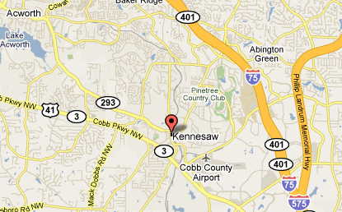

Setting goals is like building a road map. It gives us a chance to consider where we are, what we want, and how to get there.
Notes:
Without a plan, we’re more likely to wander aimlessly or waste time on tactics that won’t work.

Slide 4

KSU Goals & Initiatives
The R2 Roadmap :
is dedicated to the advancement of our faculty, students and staff who are at the epicenter of our education mission.
These goals and objectives are designed to promote pedagogical excellence, research advancement, professional development, transformative learning, community engagement, and a vibrant campus culture.
Find the complete R2 Roadmap here.
4
Notes:
This Roadmap guides our University vision to be a top-tier R2 institution.

Slide 5





KSU R2 Roadmap – Goals
Advance Community & Culture
Grow Graduate Programs & Enrollment
Promote Interdisciplinary Research with Relevance
Enhance Undergraduate Educational Experiences
Notes:
The goals outlined in the R2 Roadmap are broken down into Four Pillars.

Slide 6
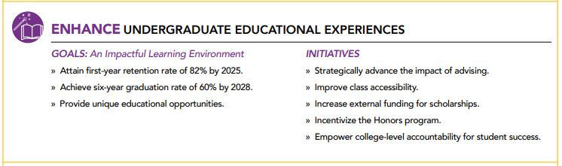
KSU R2 Roadmap – Initiatives

Slide 7
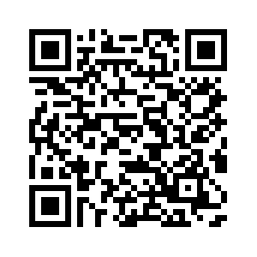
SMART GOALS built into the
R2 Roadmap
Initiatives:
Strategically advance the impact of advising.
Empower college-level accountability for student success.
Measurable
Turn long-term goals into several short-term ones.
Specific
Define how you’ll measure progress and success. If you can’t tell how you’re progressing, it’ll be harder to stay motivated.
Attain first-year retention rate of 82%
Achieve six-year graduation rate of 60%
Enhance Undergraduate Educational Experiences
Realistic
Provide unique educational opportunities
Achievable
Consider whether you have the time, energy, and resources necessary to reach each goal.
Create an impactful learning environment
Think critically and honestly about what you’re capable of achieving.
Goal: Create an impactful learning environment
Attain first-year retention rate of 82% by 2025.
Achieve six-year graduation rate of 60% by 2028.
Provide unique educational opportunities.
by 2025
by 2028
Having a due date helps you stay motivated because it gives you a finish-line celebration to look forward to and adds accountability.
SMART Goals Training
Time-bound

Slide 8
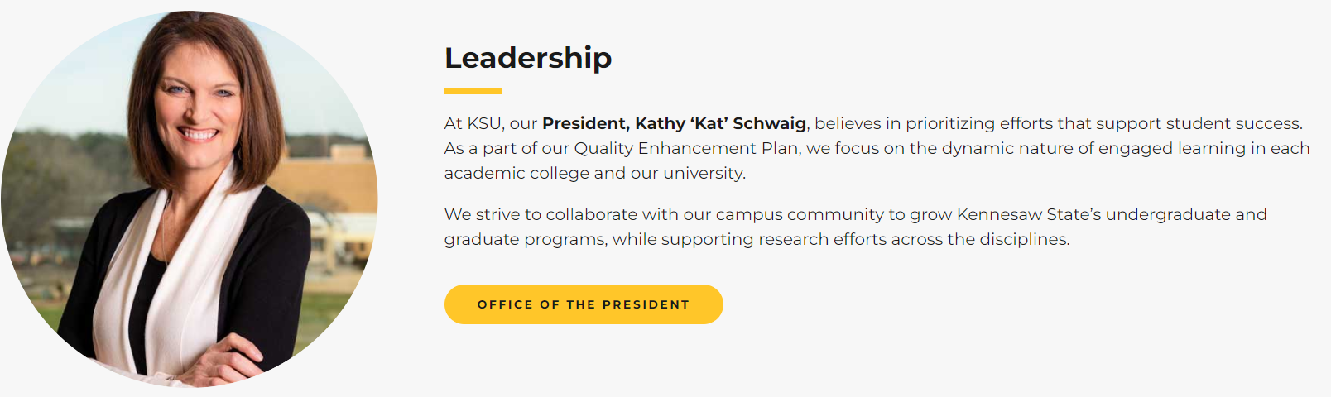
Leadership & Generating Momentum
Notes:
President’s R2 Roadmap - as the leader of the university Kat’s goals and initiatives generate enthusiasm and momentum by creating a movement. Think about how you will create a movement with your team.
Here’s a real-life example of what that looks like.

Slide 9


Slide 10
How to Start a Movement by Aligning Goals Upward
Stud­ies have shown that when employ­ees can see how their goals con­tribute to achiev­ing the university goals, they are more engaged and moti­vat­ed.
A bet­ter way to achieve this is to:
give employ­ees respon­si­bil­i­ty for set­ting their own goals and
give them the infor­ma­tion they need to ensure that their goals sup­port the university’s strate­gic goals
Notes:
We like this approach for a num­ber of rea­sons.
First­, it is sim­ple to imple­ment and does not require elab­o­rate work­flows and timeta­bles.
Sec­ond­, it gives employ­ees own­er­ship for set­ting their own objec­tives, mean­ing they are more like­ly to com­mit to achiev­ing them.
And third­, it helps employ­ees to gen­uine­ly under­stand the strate­gic pri­or­i­ties of the university and forces them to think about how their role con­tributes towards achiev­ing them.

Slide 11




Goal Setting Conversations
Clarity
Review University Strategic Goals
Set College/Division and Department Goals
Challenge
Use the tools provided to create SMART goals that align to the overall strategy
Commitment
Working together ensures your employees are comfortable and confident that the goals can be delivered
Monitor & Feedback
Keep goals “live” by discussing progress, and assessing and adapting to change
Notes:
Challenge - Employees and Managers need to work together in establishing individual goals so they align with the strategic mission
Commitment - To build joint commitment, it is better for both parties to have input in drafting and aligning goals upward
Monitor – Change is happening all the time and you can’t necessarily plan for everything. You will need to be flexible in recognizing the implications of change on performance goals/objectives and revisit them when necessary.

Slide 12
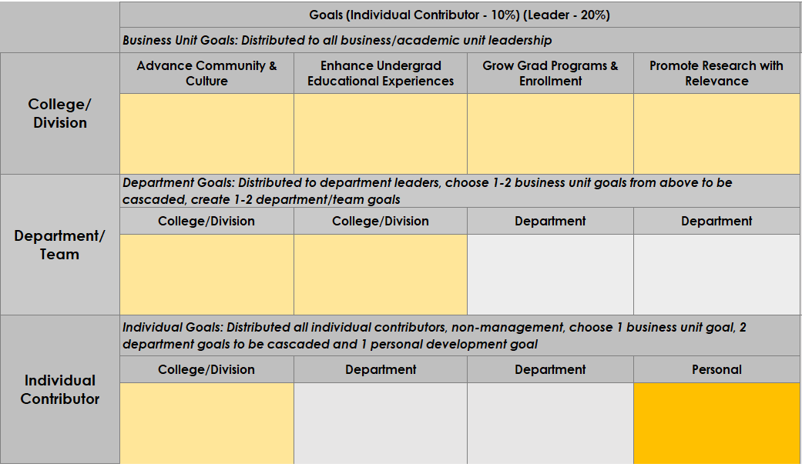
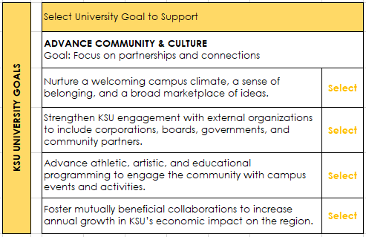
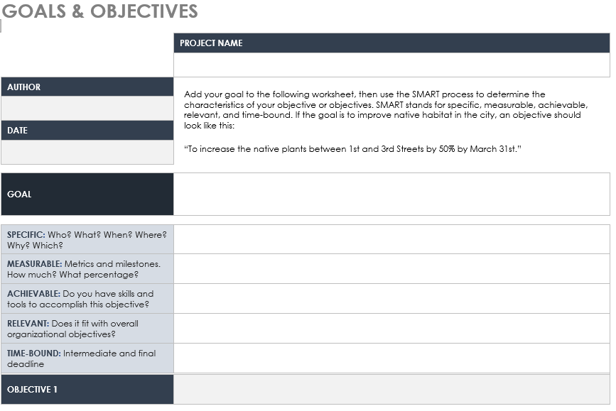
Tools for your Team
Goal Framework
Align Your Goal
Create SMART Goals

Slide 13
Goals Framework
Notes:
For employ­ees’ objec­tives to make a dif­fer­ence, they need to be aligned to the over­all strate­gic goals.
Take the anal­o­gy of dri­ving a car. Let’s say your objec­tive is to dri­ve your car for 100 miles with­out stop­ping in less than 3 hours. You com­plete the jour­ney in a sin­gle stint in under 2 hours, so you have exceed­ed your objec­tive tar­get — great. But…you were not dri­ving in the right direc­tion. So, while you tech­ni­cal­ly achieved your objec­tive, you didn’t actu­al­ly get to where you need­ed to go.
Strate­gic align­ment is about get­ting every­one mov­ing in the right direc­tion.

Slide 14
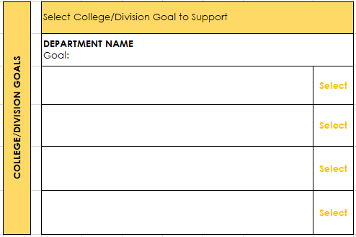
Goal Selection Worksheet

Slide 15
SMART Goals Worksheet
Work with your employees to select a university or department initiative to align their goals.
This worksheet may be used to help build SMART goals.
Don’t over commit, 1-2 strategic goals and 1-2 professional development goals is key.
Once agreed upon, Managers will enter goals in oneUSG for employees to review
Manager will approve goals in the system

Slide 16
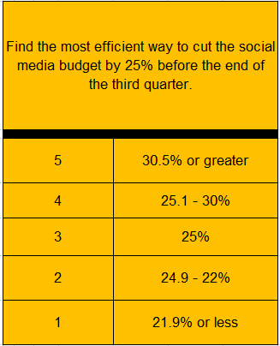
Examples
Research and read more on sample departmental goals here.

Slide 17
Timeline
Entering Goals: Define Criteria
Enter your employees' goals, submit and move form to Checkpoint 1.
March 1, 2023
All 2022 Evaluations Due
For a Manager to be eligible for a potential merit increase they must have all direct reports evaluations completed
March 20, 2023
Launching 2023 Evaluation
New form available to enter 2023 goals.
July 1, 2023
September 15, 2023
Mid-Year: Checkpoint 1
Complete mid-year check-in and move form to evaluation in progress.
January 2024
2023 - Year-end Performance Evaluation
Begin year-end self-evaluations and manager evaluations

Slide 18
Timeline: New Hires
New hire evaluation forms will be available the first of the month following 30 days of employment
Goals will need to be entered and reviewed with new employees as they are hired
New employees hired after August 1, 2023, will not be included in the 2023 evaluation process and will not receive 2023 forms
Provisional reviews for new hires (6-month probationary period) will be coming soon
Work with your HRBP or Generalist to update goals for transferring or promoted employees

Slide 19

(2023) e-Performance Sections
Individual Contributor
Leader
Goals*
Performance Factors
Leadership Factors
USG Core Values
Institutional Values
10%
20%
90%
80%
Rated but not
Weighted
Notes:
Ratings will be required for the Core & Institutional values, but they will not be counted in the overall weighted average/score. As an example, a 3 would be considered passing and a 1 would be a failing score.

Slide 20
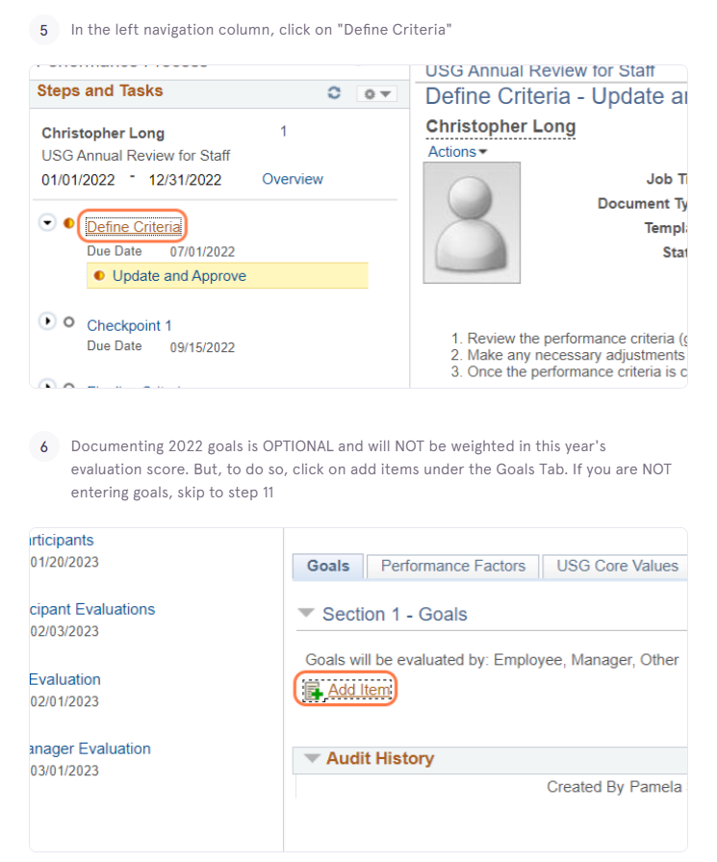
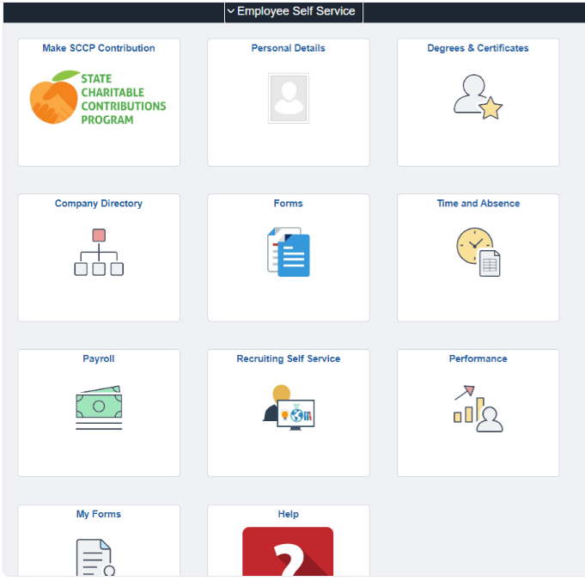
Process: Define Criteria
Launching the 2023 Evaluation
Enter Goals

Slide 21
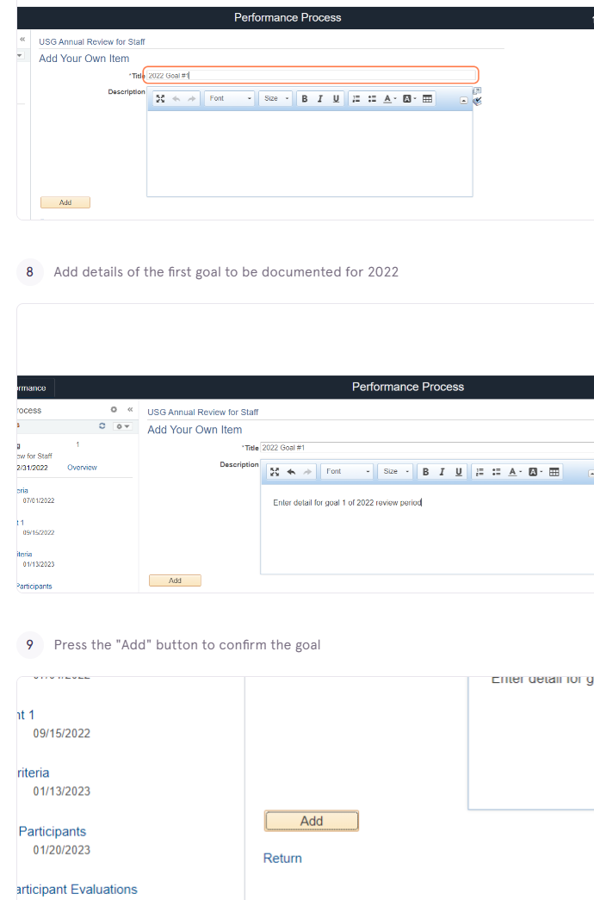
Process: Entering Goals

Slide 22
Key Points
Investing time into setting S.M.A.R.T. goals helps clarify performance expectations and provide focus throughout the performance year
You will need input from the University and College/Division strategic plans and from you as a manager in order to help establish appropriate department & individual employee goals
It is important that you work in partnership with your employees to set goals so there is mutual commitment to achieving them
There are targeted deadlines in the annual performance cycle to set and review goals, but continuous monitoring and feedback is essential to staying on track

Slide 23
Resources
R2 Roadmap
SMART Goals Training
Goal Framework & Selection Worksheet
SMART Goals Worksheet
Research More: Goal Examples by Department
Contact your HR Generalist or Business Partner for additional
assistance: Who to Contact – HR

Slide 24

Questions?
Notes:
Any Questions on Goal Writing

Slide 25
“People with goals succeed
because they know where
they’re going.”
Earl Nightingale
(American Author 1921 - 1989)
Notes:
Now that we talked about our strategic plan and shared how our Presidents vision creates momentum through SMART goals, we are excited to see how you and your teams create success for our students, community and research activities.

